Slide 1

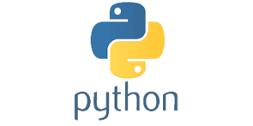
PYTHON
Lecture 37

Slide 2

Today’s Agenda
Dictionary-II
Updating Elements In Dictionary
Removing Elements From Dictionary
Functions Used In Dictionary

Slide 3
Updating A Dictionary
Since dictionary is mutable, so we can add new items or change the value of existing items using either of two ways.
These are:
assignment operator or
update( ) method of dictionary object

Slide 4
Updating Using Assignment Operator
Syntax Of Assigment Operator:
dict_var[key]=value
When we use assignment operator , Python simply searches for the key in the dictionary object.
If the key is found , it’s value is replaced with the value we have passed, otherwise a new key-value pair entry is created

Slide 5
Guess The Output ?
student_data = {1:'Amit', 2:'Brajesh',3:'Chetan', 4:'Deepak',5:'Neeraj'}
print("Before updating:")
print(student_data)
student_data[2]='Brajendra'
print("After updating:")
print(student_data)
Output:

Slide 6
Guess The Output ?
student_data = {1:'Amit', 2:'Brajesh',3:'Chetan', 4:'Deepak',5:'Neeraj'}
print("Before updating:")
print(student_data)
student_data[8]='Ankit‘
print("After updating:")
print(student_data)
Output:

Slide 7
Updating Using update( ) Method
Syntax Of update( ) Method:
dict_var.update( dict_var2)
The update( ) method merges the keys and values of one dictionary into another, overwriting values of the same key

Slide 8
Guess The Output ?
student_data = {1:'Amit', 2:'Brajesh',3:'Chetan', 4:'Deepak',5:'Neeraj'}
student_data2={2:'Brajendra',8:'Ankit'}
print("Before updating:")
print(student_data)
student_data.update(student_data2)
print("After updating:")
print(student_data)
Output:

Slide 9
Exercise
Write a program to create a dictionary called accounts
containing account id and balance of account holders .
Initialize it with the following data:
101: 50000
102:45000
103:55000
Now ask the user to input an account id and amount . If
the account id is present in the dictionary then update the
balance by adding the amount given otherwise add a new
entry of account id and balance in the dictionary. Finally
print all the accounts details.

Slide 10
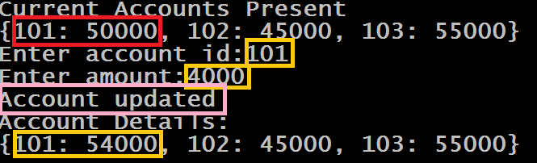
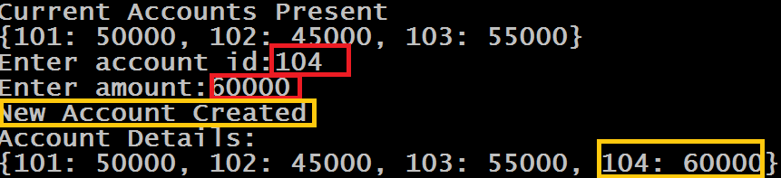
Sample Output

Slide 11
Solution
accounts={101:50000,102:45000,103:55000}
print("Current Accounts Present")
print(accounts)
id=int(input("Enter account id:"))
amt=int(input("Enter amount:"))
balance=accounts.get(id)
if balance == None:
accounts[id]=amt
print("New Account Created")
else:
newbalance=balance+amt
accounts[id]=newbalance
print("Account updated")
print("Account Details:")
print(accounts)

Slide 12
Removing Data From Dictionary
Since dictionary is mutable, so we can remove items from the dictionary.
There are certain methods available in Python to delete the items or delete entire dictionary.
These are:
pop(key): removes the entry with provided key and returns it’s value
popitem(): same as pop(), the difference being that popitem() removes an arbitary item and returns the (key,value) pair
del: deletes a single item or the dictionary entirely
clear(): clears all the items in the dictionary and returns an empty dictionary

Slide 13
The pop() Method
Syntax Of pop( ) Method:
dict_var.pop(key,[default])
The pop() method takes two parameters:
key - key which is to be searched for removal
default - (optional) value which is to be returned when the key is not in the dictionary
Return Value From pop( )
If key is found – it returns value of removed/popped element from the dictionary
If key is not found – it returns the value specified as the second argument (default)
If key is not found and default argument is not specified – it raises KeyError exception

Slide 14
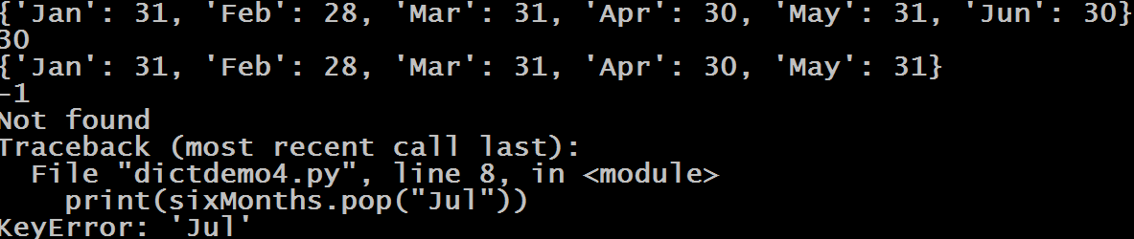
Guess The Output ?
sixMonths = {"Jan":31, "Feb":28, "Mar":31, "Apr":30, "May":31, "Jun":30}
print(sixMonths)
print(sixMonths.pop("Jun"))
print(sixMonths)
print(sixMonths.pop("Jul",-1))
print(sixMonths.pop("Jul","Not found"))
print(sixMonths.pop("Jul"))
Output:

Slide 15
The popitem() Method
Syntax Of popitem( ) Method:
dict_var.popitem( )
The popitem() method doesn’t take any parameter
Return Value From popitem( )
Selects an arbitary entry to be removed , removes it and returns that entry as a key-value pair in the form of tuple
If the dictionary is empty it raises KeyError exception

Slide 16
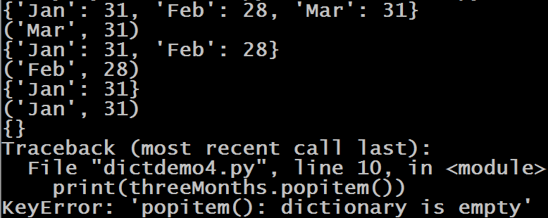
Guess The Output ?
threeMonths = {"Jan":31, "Feb":28, "Mar":31}
print(threeMonths)
print(threeMonths.popitem())
print(threeMonths)
print(threeMonths.popitem())
print(threeMonths)
print(threeMonths.popitem())
print(threeMonths)
print(threeMonths.popitem())
print(threeMonths)
Output:
Did you observe something special ?
The method popitem() removes the item that was last inserted into the dictionary. In versions before 3.7, the popitem() method removes a random item.

Slide 17
The del Operator
Just like list , Python also allows us to delete an item from the dictionary by calling the operator/keyword del
Syntax Of del Operator:
del dict_var[key]
It removes the entry from the dictionary whose key is passed as argument
If the key is not found or dictionary is empty it raises KeyError exception
If we do not pass the key then del deletes the entire dictionary object

Slide 18
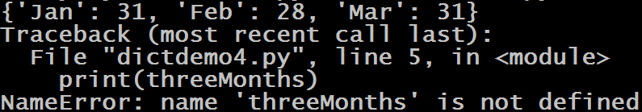
Guess The Output ?
threeMonths = {"Jan":31, "Feb":28, "Mar":31}
print(threeMonths)
del threeMonths
print(threeMonths)
Output:

Slide 19
The clear() Method
The clear() method removes all items from the dictionary.
Syntax Of clear( ) Method:
dict_var.clear( )
The clear() method doesn’t take any argument
It returns nothing ( None )

Slide 20

Guess The Output ?
threeMonths = {"Jan":31, "Feb":28, "Mar":31}
print(threeMonths)
threeMonths.clear()
print(threeMonths)
Output:

Slide 21
Functions Used With Dictionary
Like list , Python allows us to use the following functions with dictionary object
len()
max()
min()
any()
all()
sorted()
dict()

Slide 22
The len( ) Function
Returns the number of items in the dictionary
Example:
sixMonths = {"Jan":31, "Feb":28, "Mar":31, "Apr":30, "May":31, "Jun":30}
print(len(sixMonths))
Output:
6

Slide 23
The max( ) Function
Returns the greatest key present in the dictionary
Example:
sixMonths = {"Jan":31, "Feb":28, "Mar":31, "Apr":30, "May":31, "Jun":30}
print(max(sixMonths))
Output:
May

Slide 24
Guess The Output ?
sixMonths = {"Jan":31, "Feb":28, 3:31, "Apr":30 ,5:31 ,6:30}
print(max(sixMonths))
Output:

Slide 25
Guess The Output ?
sixMonths = {1:31, 2:28, 3:31,4:30,5:31,6:30}
print(max(sixMonths))
Output:
6

Slide 26
Guess The Output ?
data = {False: 10,True: 5}
print(max(data))
Output:
True

Slide 27
Guess The Output ?
data={False:0,True:1,None:2}
print(max(data))
Output:

Slide 28
Exercise
Write a program to create a dictionary called players
and accept names of 5 players and their runs from the
user. Now find out the highest score

Slide 29
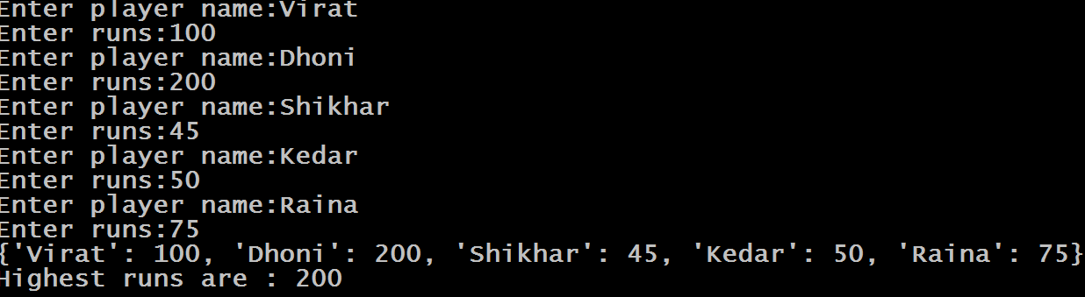
Sample Output

Slide 30
Solution
players={}
i=1
while i<=5:
name=input("Enter player name:")
runs=int(input("Enter runs:"))
players[name]=runs
i=i+1
print(players)
runs=max(players.values())
print("Highest runs are :",runs)

Slide 31
Exercise
Modify the previous code so that you are able to find out
the name of the player also who has scored the highest
score

Slide 32
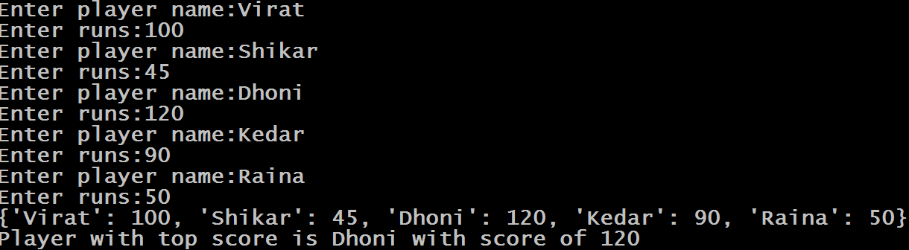
Sample Output

Slide 33
Solution
players={}
i=1
while i<=5:
name=input("Enter player name:")
runs=int(input("Enter runs:"))
players[name]=runs
i=i+1
print(players)
max=0
pl=""
for name,runs in players.items():
if runs>max:
max=runs
pl=name
print("Player with top score is",pl,"with score of",max)

Slide 34
The min( ) Function
Returns the least item present in the dictionary
Example:
sixMonths = {"Jan":31, "Feb":28, "Mar":31, "Apr":30, "May":31, "Jun":30}
print(min(sixMonths))
Output:
Apr

Slide 35

The any( ) Function
Like list and tuple , any( ) function accepts a dict as argument and returns True if atleast one element of the dict is True. If not, this method returns False. If the dict is empty, then also it returns False
Example:
data={1:31,2:28,3:30}
print(any(data))
Output:

Slide 36
Guess The Output ?
data={0:1,False:2,'':3}
print(any(data))
Output:

Slide 37
Guess The Output ?
data={'0':1,False:2,'':3}
print(any(data))
Output:

Slide 38
Guess The Output ?
data= { }
print(any(data))
Output:

Slide 39
The all( ) Function
The all( ) function accepts a dict as argument and returns True if all the keys of the dict are True or if the List is empty .If not, this method returns False.
Example:
data={1:31,2:28,3:30,0:10}
print(all(data))
Output:

Slide 40
Guess The Output ?
data={1:31,2:28,3:30}
print(all(data))
Output:

Slide 41
Guess The Output ?
data={'0':1,True:2,' ':3}
print(all(data))
Output:

Slide 42
Guess The Output ?
data= { }
print(all(data))
Output:

Slide 43
The sorted( ) Function
Like it is with lists and tuples, the sorted() function returns a sorted sequence of the keys in the dictionary.
The sorting is in ascending order, and doesn’t modify the original Python dictionary.

Slide 44
Guess The Output ?
sixMonths = {"Jan":31, "Feb":28, "Mar":31, "Apr":30, "May":31, "Jun":30}
print(sorted(sixMonths))
print(sixMonths)
Output:

Slide 45
Guess The Output ?
sixMonths = {"Jan":31, "Feb":28, "Mar":31, "Apr":30, 4:31, 5:30}
print(sorted(sixMonths))
Output:

Slide 46
Guess The Output ?
sixMonths = {"Jan":31, "Feb":28, "Mar":31, "Apr":30, "May":31, "Jun":30}
print(sorted(sixMonths,reverse=True))
Output:

Slide 47

The dict( ) Function
As previously mentioned the dict( ) function can be used to create dictionaries . It can accept key-value pairs or iterable or mappings as argument and converts them into dictionaries
Example:
months = dict(Jan=31,Feb=28)
print('months = ',months)
print(type(months))
Output:

Slide 48
Guess The Output ?
months = dict([('Jan',31),('Feb',28)])
print('months = ',months)
Output:

Slide 49
Guess The Output ?
months = dict((('Jan',31),('Feb',28)))
print('months = ',months)
Output:

Slide 50
Guess The Output ?
months = dict({'Jan':31,'Feb':28})
print('months = ',months)
Output:

Slide 51
Guess The Output ?
months = dict(12)
print('months = ',months)
Output:

Slide 52
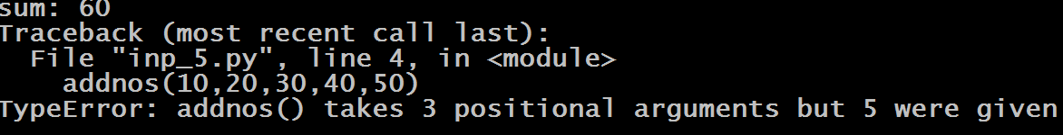
The kwargs Function Argument
To understand kwargs , try to figure out the output of the code below
Example:
def addnos(x,y,z):
print("sum:",x+y+z)
addnos(10,20,30)
addnos(10,20,30,40,50)
Output:

Slide 53
The kwargs Function Argument
To overcome this problem , we used the technique of variable length arguments, where we prefix the function parameter with an asterisk
This allows us to pass any number of arguments to the function and inside the function they are received as tuple

Slide 54

The args Function Argument
def addnos(*args):
sum=0
for x in args:
sum=sum+x
print("sum:",sum)
addnos(10,20,30)
addnos(10,20,30,40,50)
Output

Slide 55
The args Function Argument
Using *args , we cannot pass keyword arguments
So , Python has given us a solution for this ,called **kwargs, which allows us to pass the variable length of keyword arguments to the function.

Slide 56
The kwargs Function Argument
In the function, we use the double asterisk ** before the parameter name to denote this type of argument.
The arguments are passed as a dictionary and the name of the dictionary is the name of parameter
The keywords become keys and the actual data passed becomes values

Slide 57
The kwargs Function Argument
def show_details(**data):
print("\nData type of argument:",type(data))
for key, value in data.items():
print("{} is {}".format(key,value))
show_details(Firstname="Sachin", Lastname="Kapoor", Age=38, Phone=9826012345)
show_details(Firstname="Amit", Lastname="Sharma", Email="amit@gmail.com", Country="India", Age=25, Phone=9893198931)

Slide 58
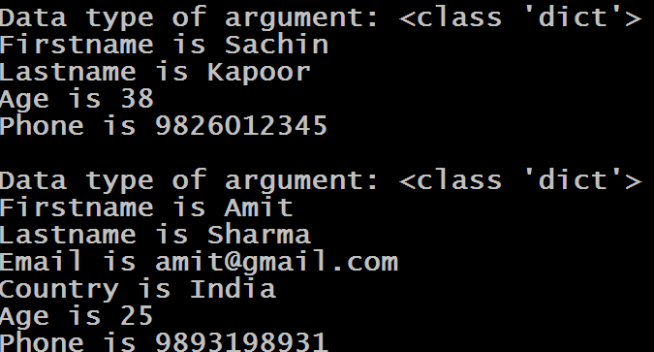
The kwargs Function Argument

